Slide 1

Entity Resolution Framework for Big Data
Data Science
Data Analysis
Data Mining
(1806059)
(1806060)
(1806068)
(1806458)
(1806486)
Sakshi Rai
Samdarshi jha
Shashikant Singh
Ananya
Manisha Godara
Under The Guidance Of Prof. Bhaswati Sahoo

Slide 2

ENTITY RESOLUTION
Problem of identifying and linking/grouping different manifestations of the same real world object.
Examples of manifestations and objects:
• Different ways of addressing (names, Email addresses, FaceBook
accounts) the same person in text.
• Web pages with differing descriptions of the same business.
• Different photos of the same object.
This clearly has many applications, particularly Linking Census Records, public health data, web search, comparison shopping, law enforcement, and more.

Slide 3

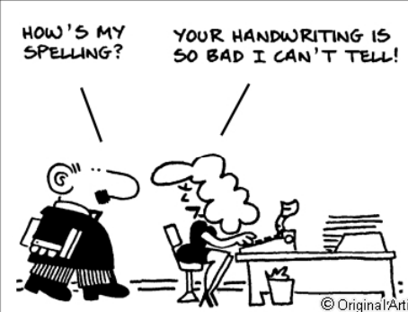


TRADITIONAL CHALLENGES IN ER
• Name/Attribute ambiguity
• Errors due to data entry
• Missing Values
• Changing Attributes
• Data formatting
• Abbreviations / Data Truncation

Slide 4
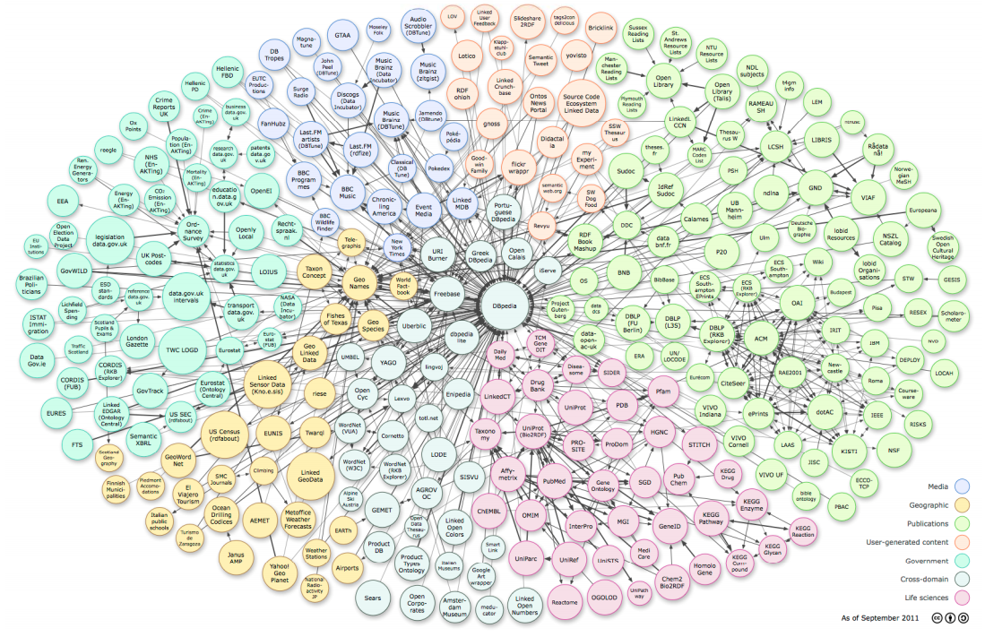
BIG DATA CHALLENGES IN ER
• Larger and more Datasets Need efficient parallel techniques
• Unstructured, Unclean and Incomplete data. Diverse data types.
• Need to infer relationships in addition to “equality”
• Deal with structure of entities (Are Walmart and Walmart Pharmacy the same?)

Slide 5
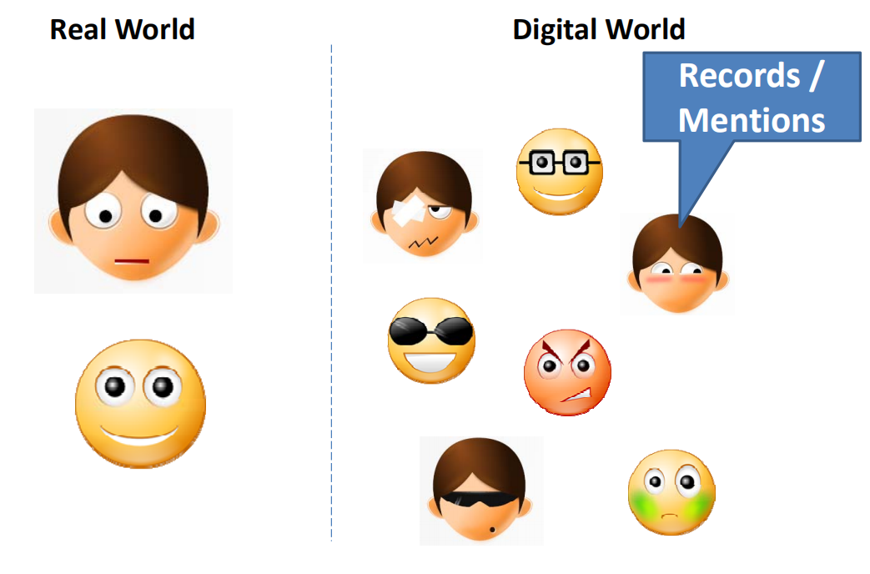
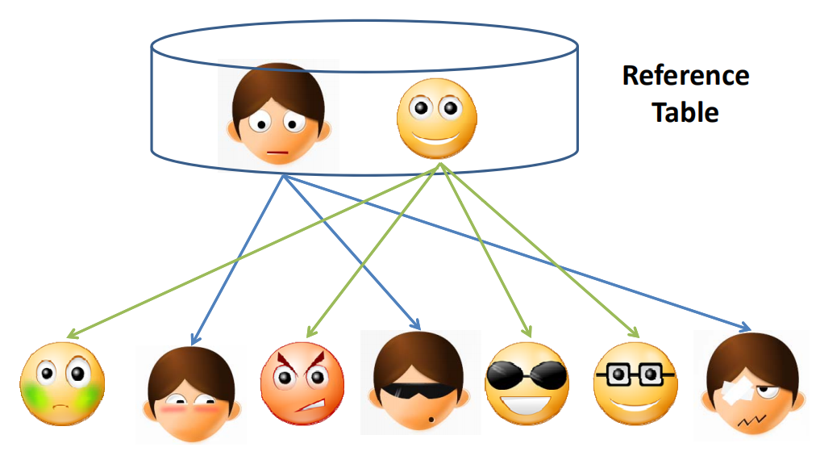
TASKS IN ENTITY RESOLUTION
There exists in the real world entities, and in the digital world, records and mentions of those entities. The records and mentions may take many forms, but they all refer to only a single real world entity.
We can therefore discuss the ER problem as one involving matching record pairs corresponding to the same entity, and as a graph of related records/mentions to related entities.

Slide 6
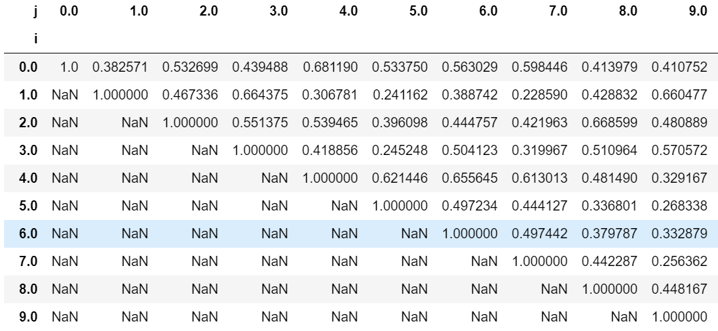
THE GOAL
The goal is to construct, for a pair of records, a “Comparison Matrix” of similarity scores of each component attribute.
Similarity scores can simply be Boolean (match or non-match) or they can be real values with distance functions.
After we have constructed a vector of component-wise similarities for a pair of records, we must compute the probability that the pair of records is a match.

Slide 7


WORKFLOW
Pairwise
Matching
Blocking
Binning
Check Column
Types in Data
Data
Preparation
Entity Resolution
Framework
Get Data
By Similarty Score Matrix

Slide 8
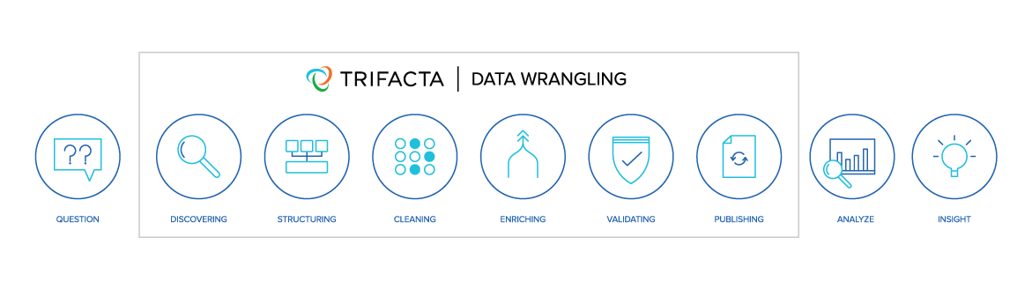
DATA PREPARATION
The first tasks of schema and data normalization are required preparation for any Entity Resolution Algorithms. In this task, schema attributes are matched (e.g. contact number vs phone number), and compound attributes like addresses are normalized. Data normalization involves converting all strings to upper or lower case and removing whitespace. Data cleaning and dictionary lookups are also important.

Slide 9
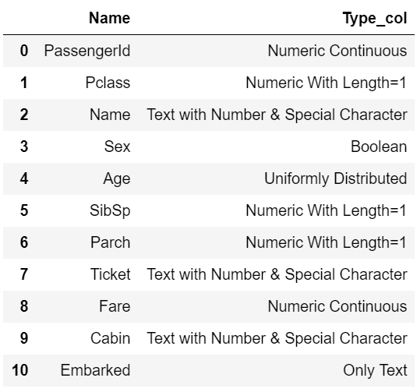
ANALYSING ATTRIBUTES
It is important to determine the types of columns present in a database. It give a clear view to perform any sort of analytical operations. In our Module we determine following types:
a
Constant
Boolean
Numeric With Length=1
Numeric Continuous
Uniformly Spaced
Non-Uniformly Spaced
Uniformly Distributed
Date
Only Text
Text with Number & Special Character
TITANIC DATASET EXAMPLE

Slide 10

BINNING
Sometimes numerical values make more sense if clustered together. Data binning, which is also known as bucketing or discretization, is a technique used in data processing and statistics. Binning can be used for example, if there are more possible data points than observed data points.
pandas.cut() Bin values into discrete intervals. Use cut when you need to segment and sort data values into bins.
pandas.cut

Slide 11
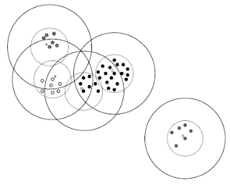
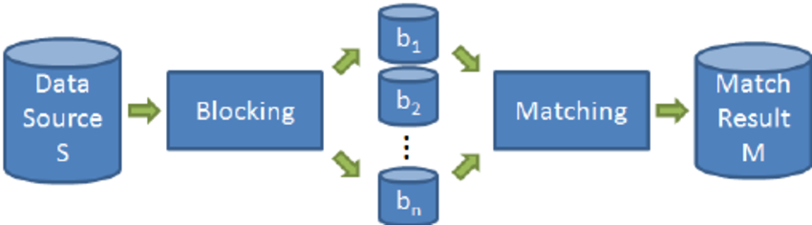
BLOCKING
The first approach to scaling to big data is to use a blocking approach. Consider a Naïve pairwise comparison with 1,000 business mentions from 1,000 cities. This is 1 trillion comparisons, which is 11.6 days with ms comparisons! However, we know that business mentions are probably city-specific, therefore only comparing mentions within cities reduces the comparison space to the more manageable 1 billion comparisons, which takes only 16 minutes at the same rate.
a
It cluster similar entities into blocks so that pair-wise comparisons are executed only between co-occurring entities.

Slide 12
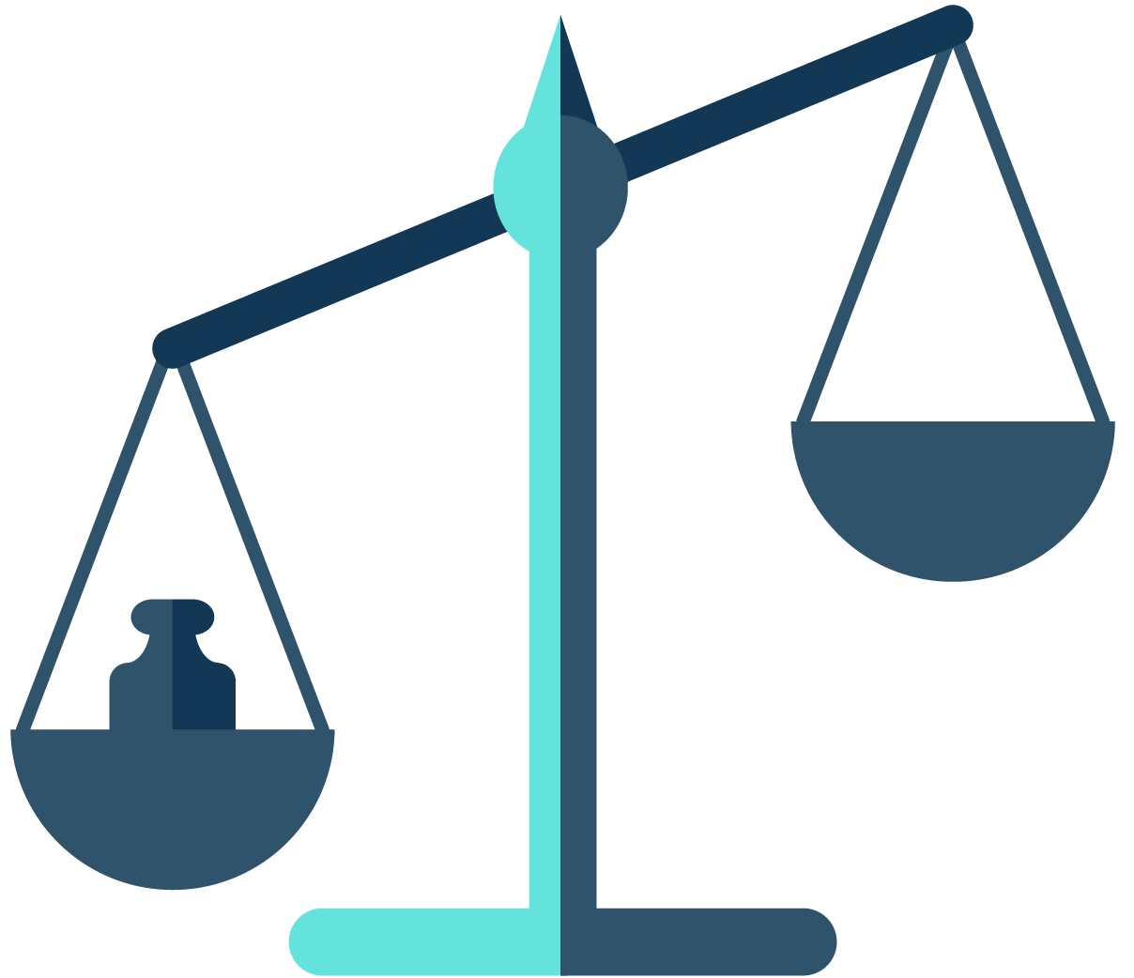
PAIRWISE MATCHING
It finds the similarity score across all records in a dataframe. We must compute the probability that the pair of records is a match. There are several methods for discovering the probability of a match. Two simple proposals are to use a weighted sum or average of component similarity scores, and to use thresholds.
Phonetic
Damerau Levenshtein
S-Waterman
Metaphone
Monge Eklan
Levenshtein
Pairwise
Matching
NYSIIS
Jaro Winkler
Jaccard
Similarity
Score Matrix
Soundex
Cosine String
Soft TFIDF

Slide 13

CONCLUSION
Entity resolution is becoming an increasingly important task as linked data grows, and the requirement for graph based reasoning extends beyond theoretical applications. With the advent of big data computations, this need has become even more prevalent.
As data, noise, and knowledge grows , greater the needs & opportunities for intelligent reasoning about entity resolution.

Slide 14


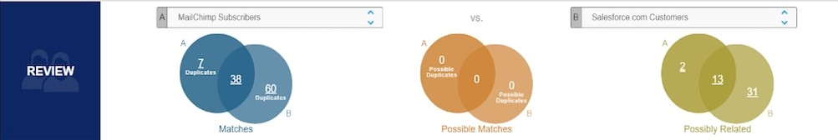
FIRST EVER COMPANY
Senzing is the First Blue Chip Company to Introduce Real-Time AI For Entity Resolution. Jeff Jonas and team developed a vision to revolutionize entity resolution.

Slide 15
THANK YOU!
Notes:
You can safely remove this slide. This slide design was provided by SlideModel.com – You can download more templates, shapes and elements for PowerPoint from http://slidemodel.com

